Slide 1
Ultrasonic Mapping Scout
Eric Lund
Richard MacGregor
Chris Williams
(Group 11)
Notes:
EL

Slide 2
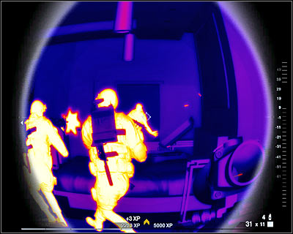
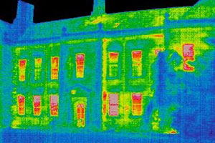
Existing Technologies
Heads-up displays
Satellite imaging
Notes:
CW

Slide 3

Existing Technologies
Heads-up displays
Satellite imaging
Notes:
CW

Slide 4
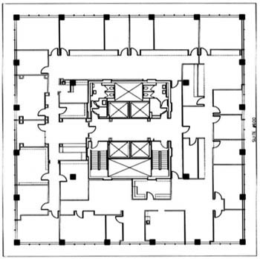
Problem
You cannot see the inside of the building
Knowing structure leads to:
  Safer entries
  Reduced danger
  Reduced casualties
  and injuries
Notes:
RM

Slide 5
Solution
Create a device that will map out the interior of these buildings
  Automatically navigate structure
  Detect distance to walls
  Wirelessly transmit distance information
  Display on wireless console
Notes:
EL

Slide 6
Properties
Unmanned
  Closest person would be outside building
Must easily navigate structures
Should give rough estimate of interior structures
Notes:
EL

Slide 7
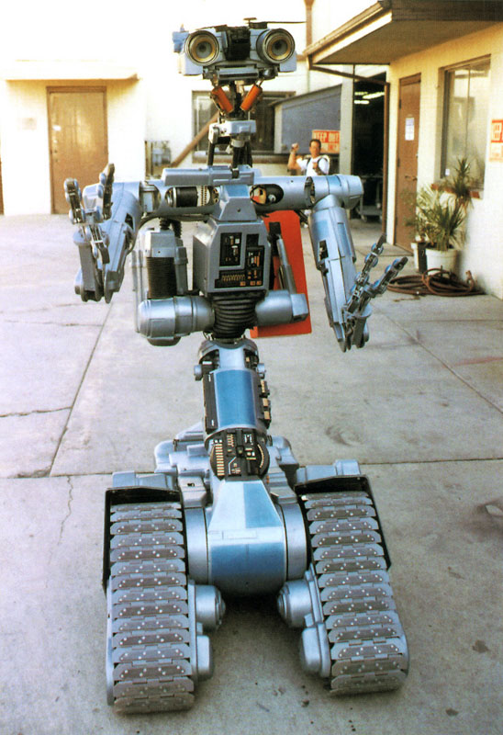
Our Prototype
Johnny 5!
Ok, not really
Notes:
CW

Slide 8
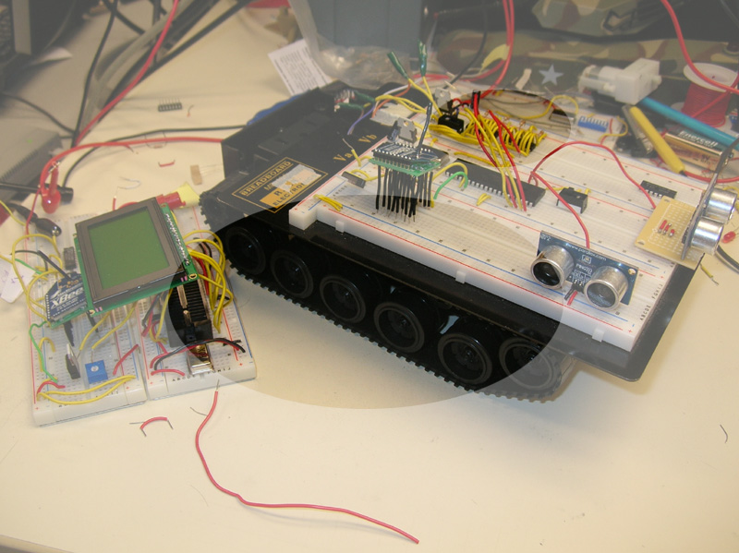
Our Real Prototype
Major Parts:
  A gutted RC Tank
  Ultrasonic Transducers
  Zigbee Wireless
  128x64 Monochrome LCD
Notes:
Chris – H Bridges

Slide 9
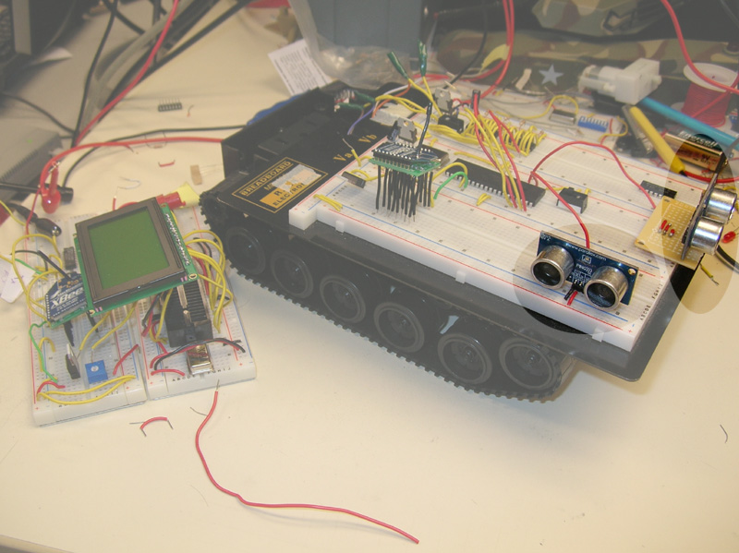
Our Real Prototype
Major Parts:
  A gutted RC Tank
  Ultrasonic Transducers
  Zigbee Wireless
  128x64 Monochrome LCD
Notes:
Eric – ultrasound and movement control/positioning

Slide 10
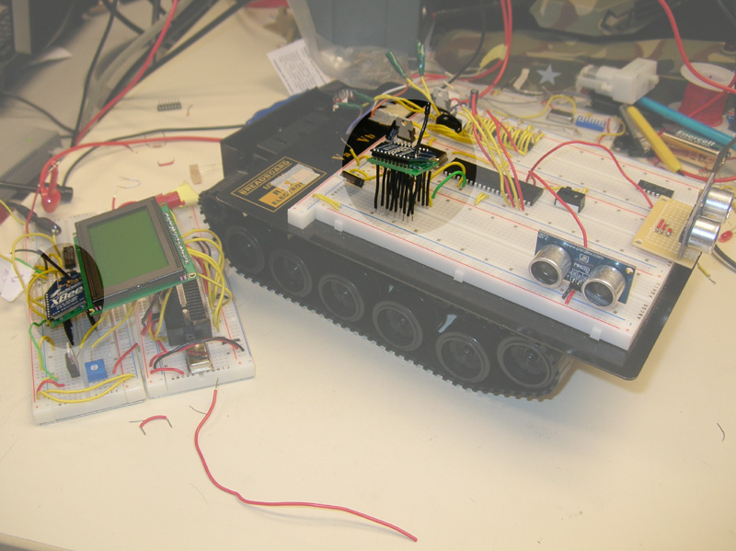
Our Real Prototype
Major Parts:
  A gutted RC Tank
  Ultrasonic Transducers
  Zigbee Wireless
  128x64 Monochrome LCD
Notes:
Richard

Slide 11
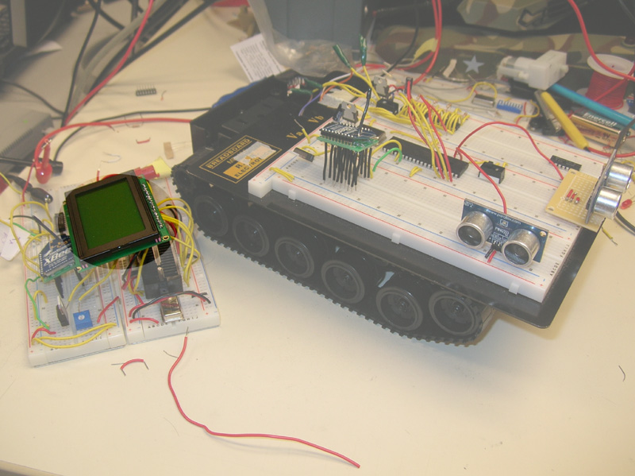
Our Real Prototype
Major Parts:
  A gutted RC Tank
  Ultrasonic Transducers
  Zigbee Wireless
  128x64 Monochrome LCD
Notes:
Chris

Slide 12
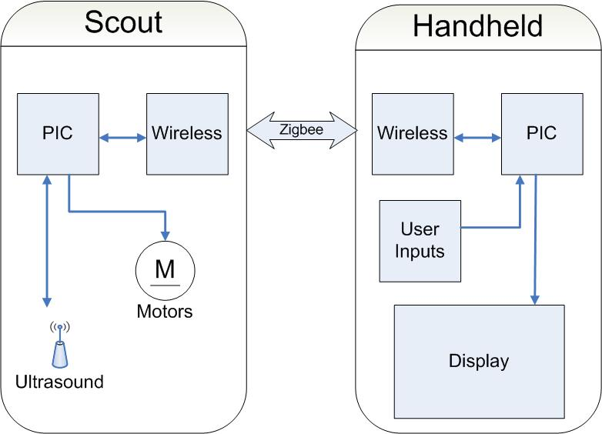
Block Diagram
Notes:
Chris

Slide 13
Zigbee
A specification for a suite of communication protocols based on the IEEE 802.15.4 standard
The Digi Xbee modules have flexible modes
Uses basic RS-232 communication protocols
Can be reprogrammed for use in varying situations using:
  1 coordinator, x routers, & y end devices.
Notes:
Richard

Slide 14
Zigbee: Problems & Solutions
Microchip's Zigbee modules were cheap, but large include files were required and very difficult to use.
The Digi Xbee module's protocol was built into the chip itself, very easy to use and used a protocol that was familiar.
Digi Xbee modules came with a non-breadboard compatible pin layout.
SOLDER!
Notes:
Richard

Slide 15
Distance Computation
Why?
  To accurately create a map we need a coordinate system
How It Works
  Angular velocity of the wheel, time, relative angle
  Sensors add to the relative position for walls
Notes:
Eric

Slide 16
Movement Controls
Scout will follow the right wall
When you approach a wall the scout
will turn into the open direction
The scout will keep itself aligned in case
of angled walls by the last 3 sensor readings

Slide 17
Remaining Work
Sensor Calibration
Motor sensor integration
Make sure stuff doesn’t blow up

Slide 18
Ultrasonic Mapping Scout
Eric Lund
Richard MacGregor
Chris Williams
(Group 11)

